Slide 1

ONLINE QUIZ SYSTEM
Department of IT&CA
Master Of Computer Application
Under Esteemed Guidance
Respected Rajendra Kumar Dwivedi
Respected Jay Prakash

Slide 2
ONLINE QUIZ SYSTEM
Online Quiz System is a cost-effective, scalable way to convert traditional pen and paper-based exams to online and paperless mode.

Slide 3
Introduction and Objectives
Online examination system refers to service as conduct or test.
Online Quiz system will use in schools, colleges, universities, institutes for conduct quiz in online mode.
It is useful to evaluate the students knowledge using modern computer technology without any effects on the traditional university course exam that uses pens, papers invigilators.
Online Quiz System is a cost-effective, scalable way to convert traditional pen and paper-based exams to online and paperless mode.

Slide 4
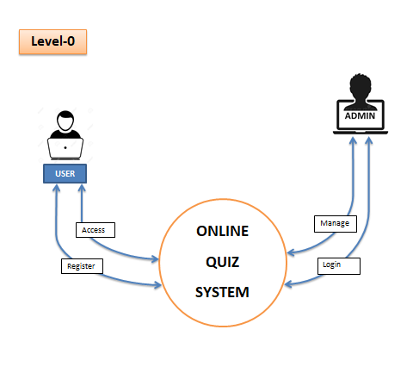
Data Flow Diagram

Slide 5
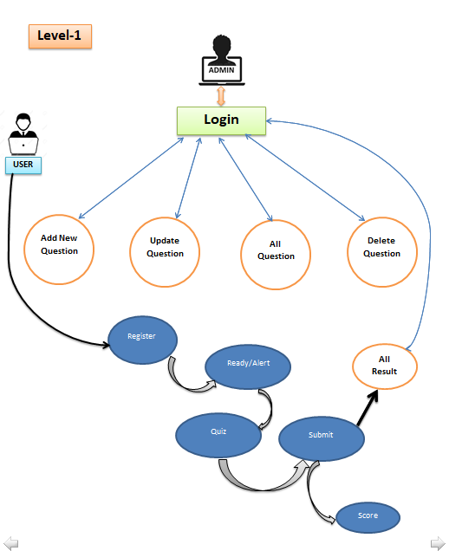

Slide 6
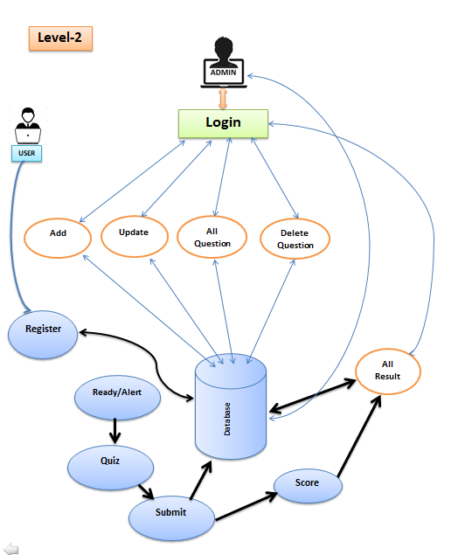

Slide 7
IMPLEMENTATION DETAILS
Back End :JAVA(JFrame)
Front End :JAVA usingSERVLETS
Database Connectivity :MySQL(Connector/J driver)
Database : MySQL

Slide 8
Software needs to run My Project
JAVA JDK,JRE
Netbeans Editor/Eclips Editor
MySQL Databse
MySQL(Connector/Jdriver) rs2xml Connector
MySql Server/TomCat Server

Slide 9
Software & Hardware
Operating System : Windows
Programming Language : JAVA
Database : MySQL
Server : MySQL Server
Processor : 1.3 GHz
Hard Disk : 10 Gb
RAM : 256 Mb
Monitor : VGA/LCD Refrences:

Slide 10
Module & Snapshots
I have worked on two modules in my project one is for Admin Module and one is for Students module.
I have focused mostly on admin Modules that how can admin add new question, delete question , update question adn check all the results etc.
Snapshots to be continue from next page

Slide 11

Index

Slide 12

Admin

Slide 13
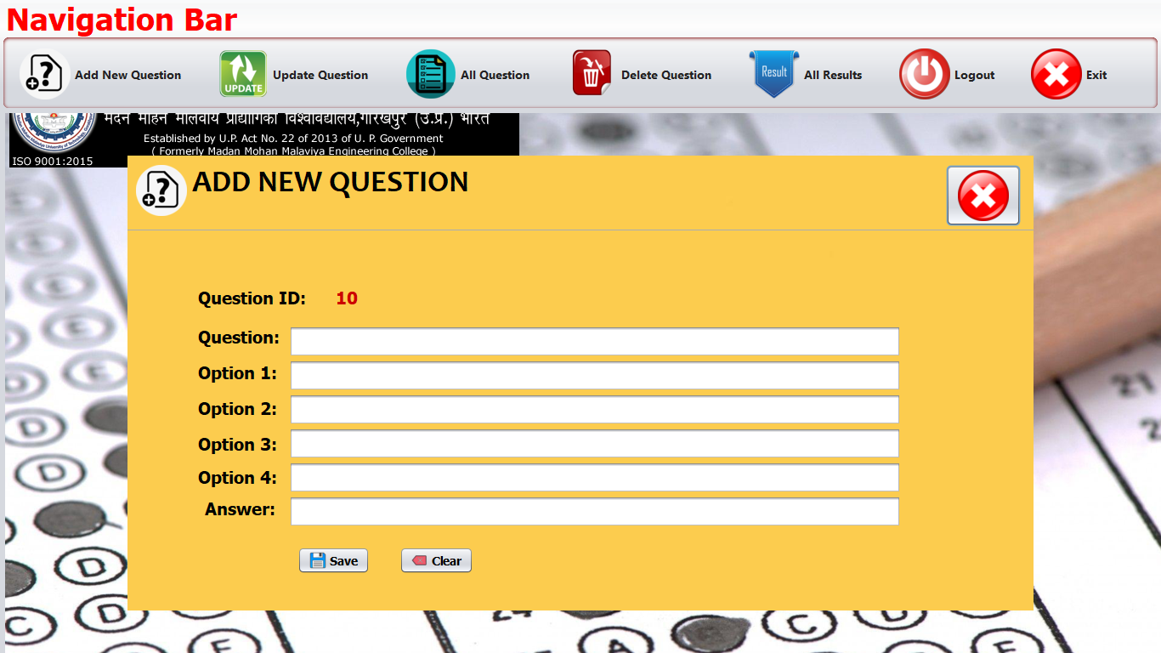
Add New Question

Slide 14
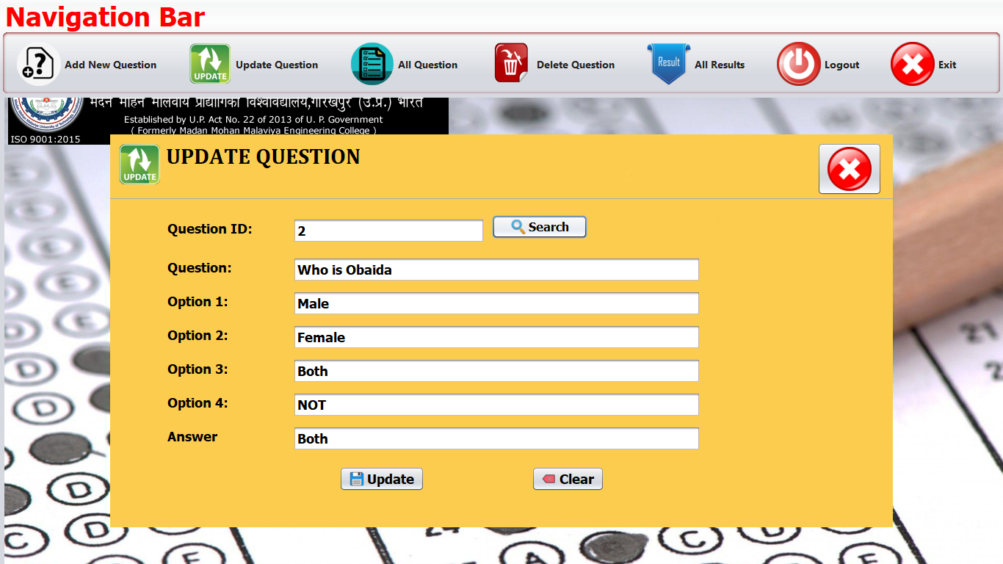
Update Question

Slide 15
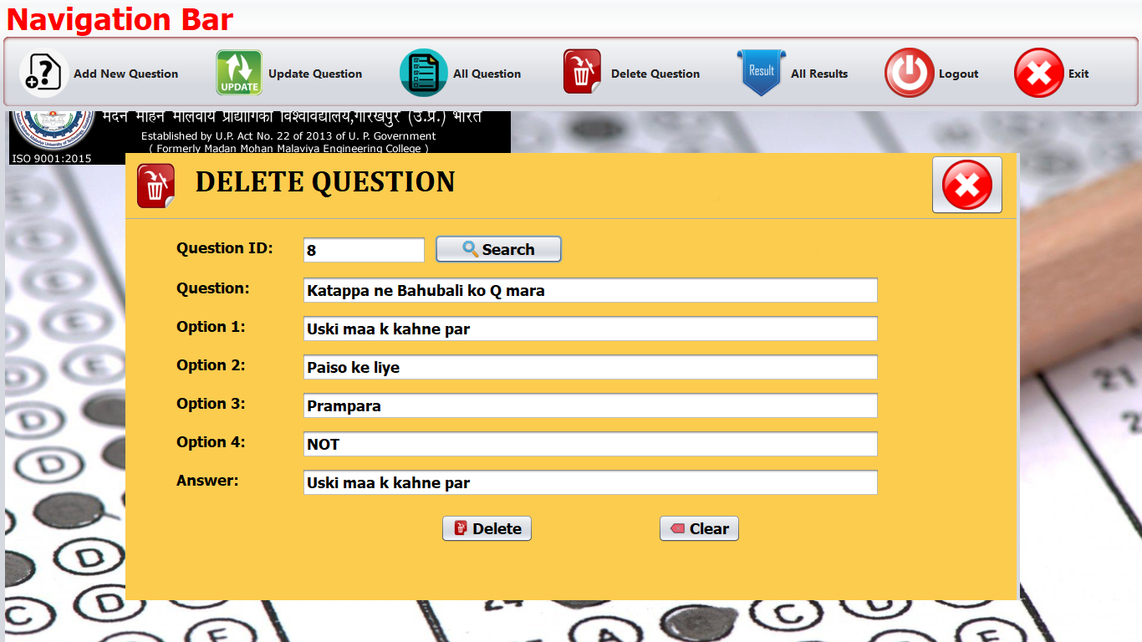
Delete Question

Slide 16
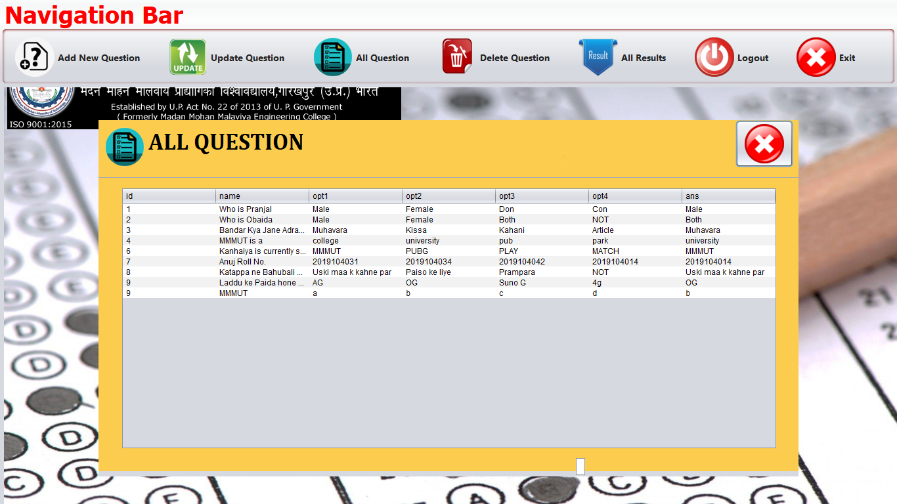
All Question

Slide 17
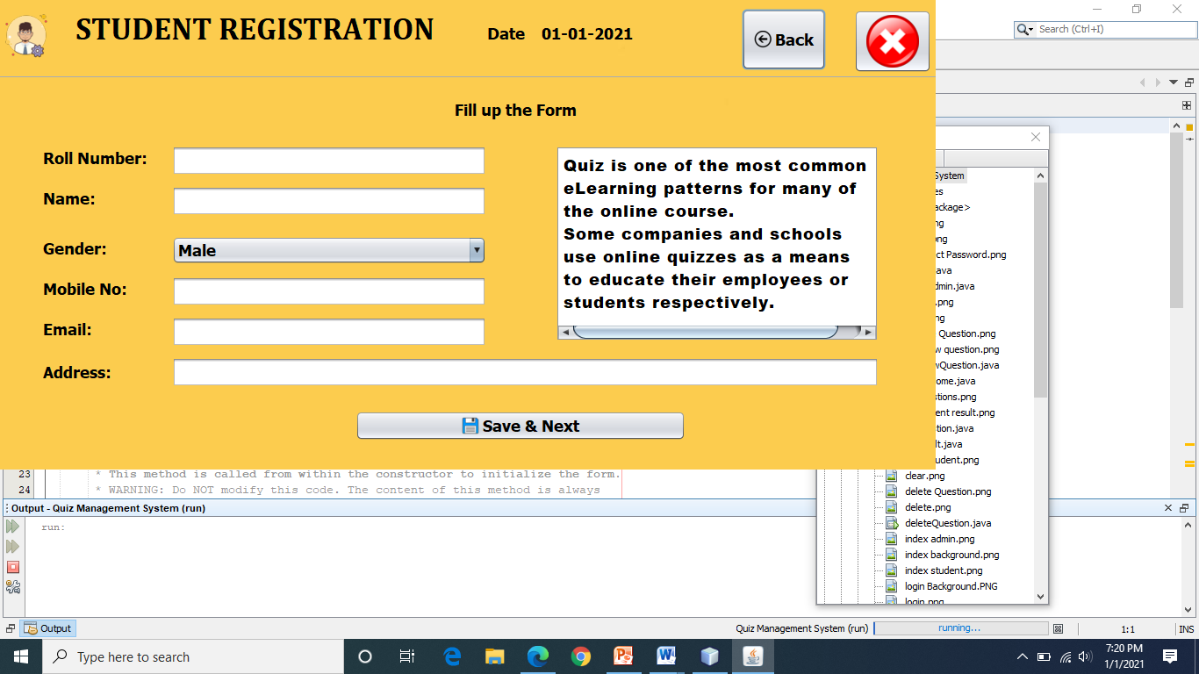
Student Registration

Slide 18
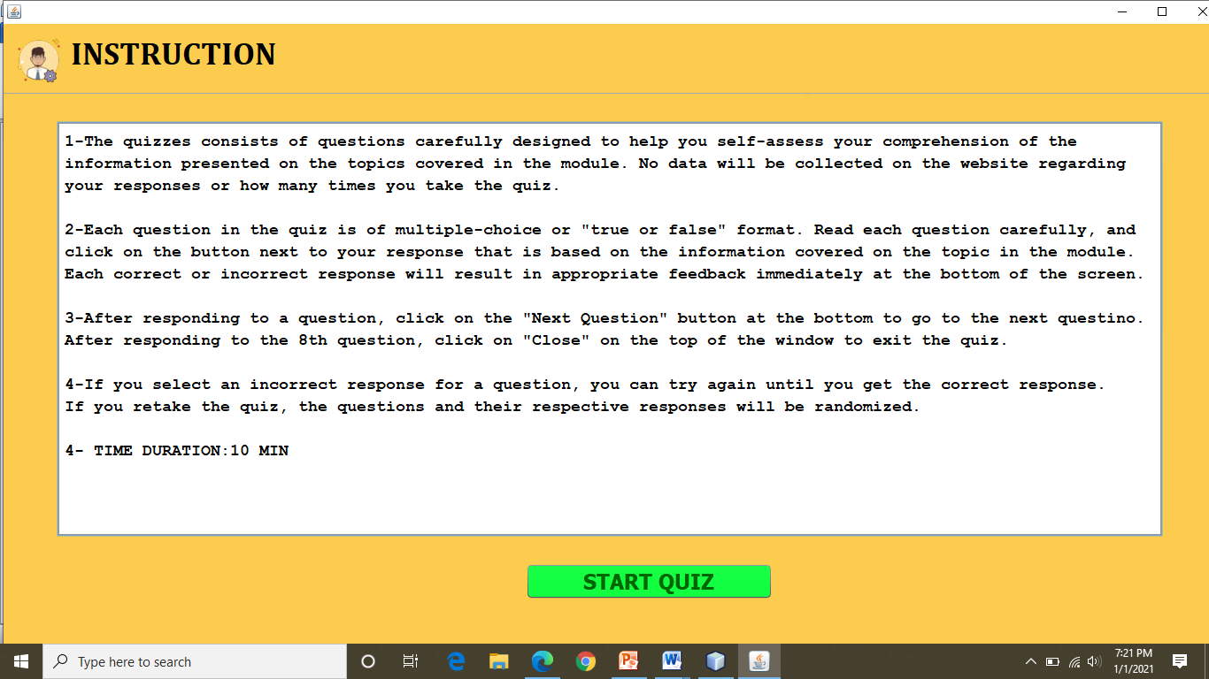
Quiz Instruction

Slide 19
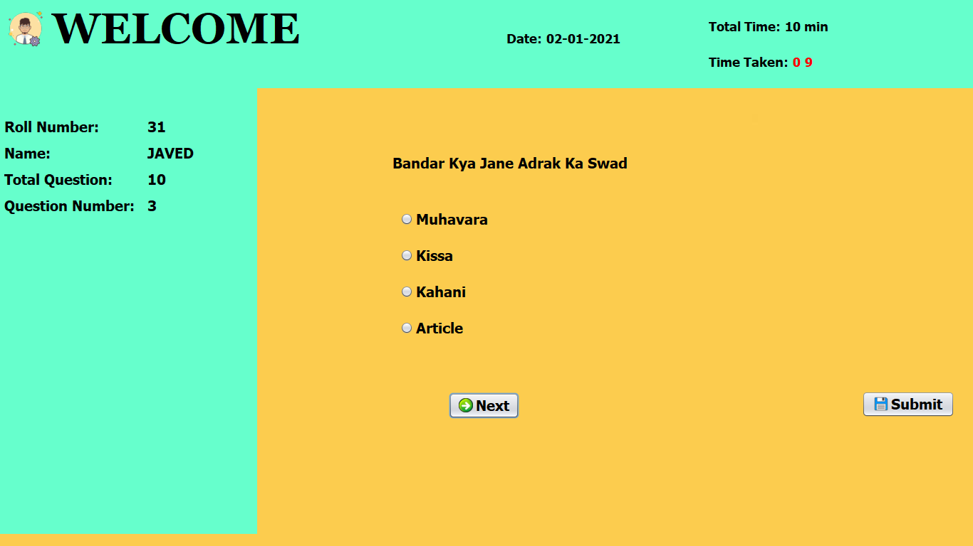
Main Quiz Page

Slide 20

Submitted by Students

Slide 21
SUMMARY AND CONCLUSION
This project has helped us in getting a clearer understanding of real world application development.
It has provided us a deeper insight into connecting databases with servers.
The entire learning outcome of this project has proved to be immensely beneficial for our future application development.

Slide 22
References
https://www.tutorialspoint.com/java
https://www.tutorialspoint.com/java
https://www.youtube.com/

Slide 23
ONLINE QUIZ SYSTEM
Name :JAVED ALAM KHA
Roll No. :2019104031
Branch :MCA (2nd Year)
Department :IT&CA
Sumbitted to: Submitted By:
Respected Rajendra Kumar Dwivedi Javed Alam Kha

Slide 24


